Slide 1
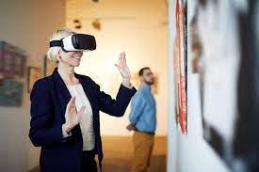
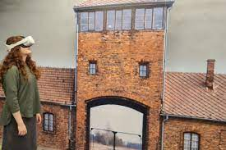
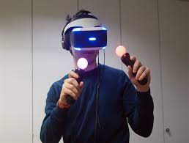
VR Tour : Man and the Living World Museum
Creating an infrastructure for setting up exhibitions dynamically in virtual reality
A project by: Yakir Zafrani & Bar Yaron
Notes:
להסביר על עצמנו בקצרה על הרקע שלנו ולמה בחרנו בפרוייקט הזה

Slide 2
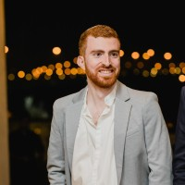

About Us
Yakir Zafrani
Bar Yaron
Embedded Developer at Bird Aerosystems
Q.A and Automation engineer at Harel Insurance & Finance.
Notes:
להסביר על עצמנו בקצרה על הרקע שלנו ולמה בחרנו בפרוייקט הזה. בר ויקיר ביחד כל אחד על עצמו באופן אישי מה רצה להשיג בפרויקט איזה טכנולוגיות מעניינות אותו וכל דבר אחר שיכול להיות רלוונטי בקשר בינינו לבין הפרויקט

Slide 3
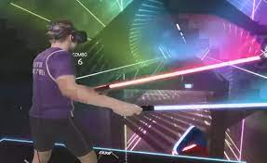
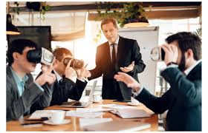
What is Virtual Reality (VR)?
A simulated experience that employs pose tracking and 3D near-eye displays to give the user an immersive feel of a virtual world
Applications of virtual reality : entertainment (i.e video games), education, medical or military training and business (i.e virtual meetings)
Notes:
להסביר רקע כללי על מציאות מדומה- יקיר

Slide 4
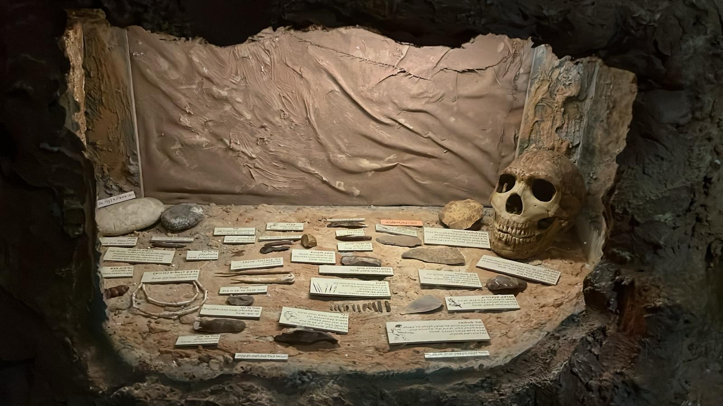
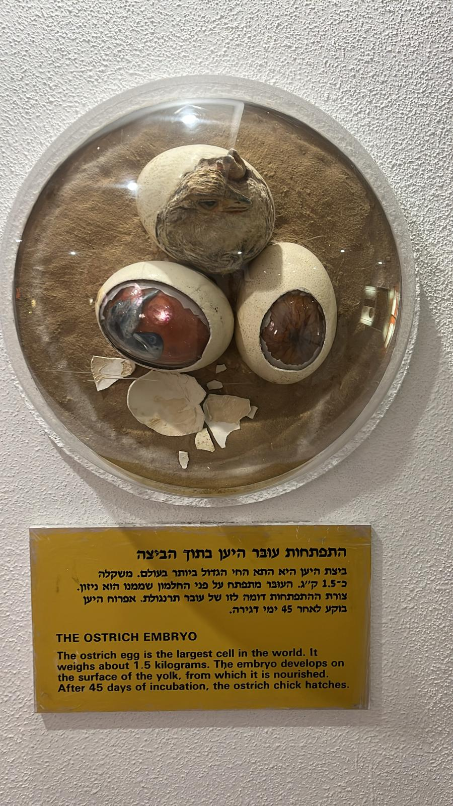
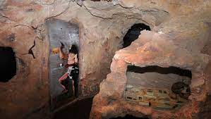
The “ Man and the Living World” Museum
A nature museum that was established in 1983 located in Ramat Gan, Israel
Examples of exhibitions and activities at the museum
Notes:
להסביר בקצרה על המוזיאון ואיך הגענו לעבוד איתו דוגמא לתערוכה קבועה

Slide 5
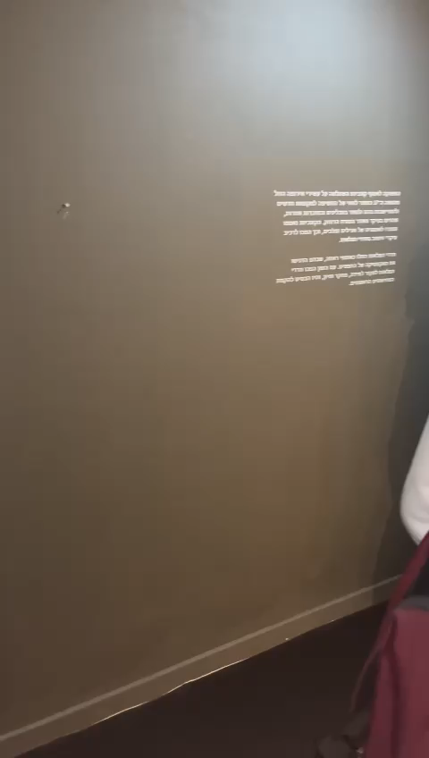
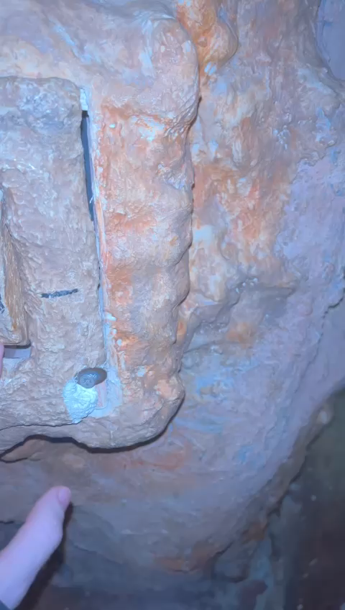
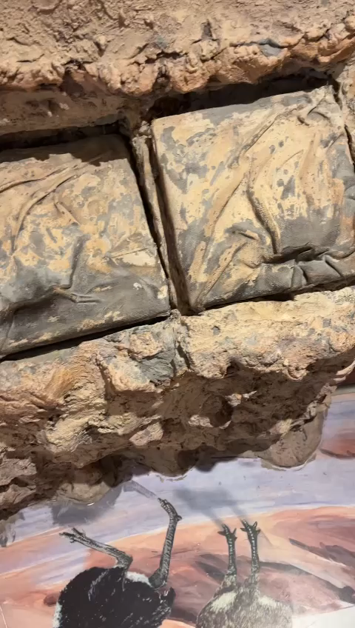
The “ Man and the Living World” Museum
A slight impression from our experience in the museum
Notes:
להראות קצת סרטונים ותמונות מהחוויה בביקור שלנו במוזיאון

Slide 6
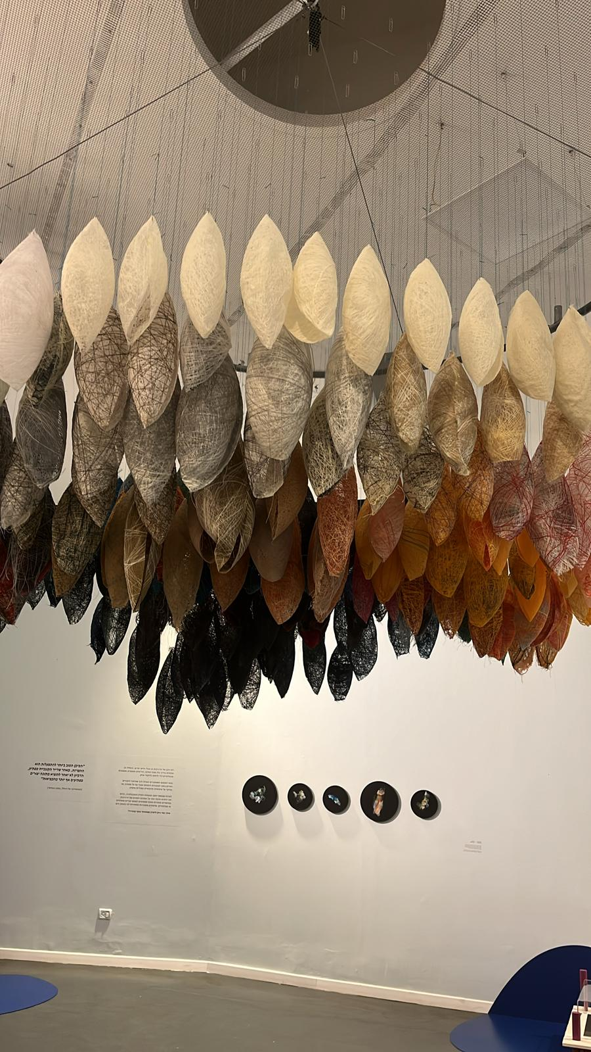
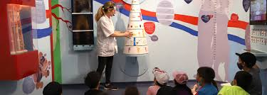
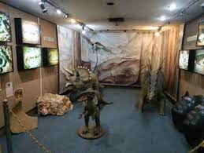
The “ Man and the Living World” Museum
Suitable for children
Describes the relationship between the man and the nature
Displays different viewpoints & timelines
The museum spaces holds two types of exhibitions
Permanent
Temporary
Examples of exhibitions and activities at the museum
Notes:
דוגמא לתערוכה משתנה

Slide 7
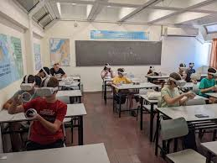
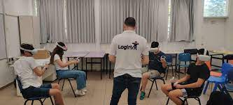
VR In Education
VR offers learners an immersive and interactive learning experience
allowing to comprehend challenging concepts and ideas more efficiently and effectively
Notes:
להסביר רקע כללי על מציאות מדומה- יקיר

Slide 8
Project Goals
To develop a new unique experience for the museum in order to attract new and diverse audiences
To give a new and accessible way to enjoy some of the museum’s content
To perform a “remaster” for some outdated content in the museum and deliver it in a fresh and modern way.
Notes:
להסביר על מטרות הפרויקט

Slide 9
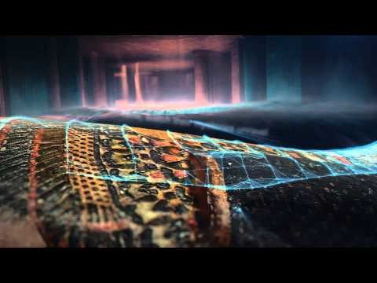
Market Search
The British Museum (UK) & Oculus : "Curators' Corner: Animal Mummies."
Notes:
להציג כמה מתחרים- סרטונים ביוטיוב/כתבות
Users can interact with 3D models of the artifacts and listen to expert commentary from museum curators.

Slide 10
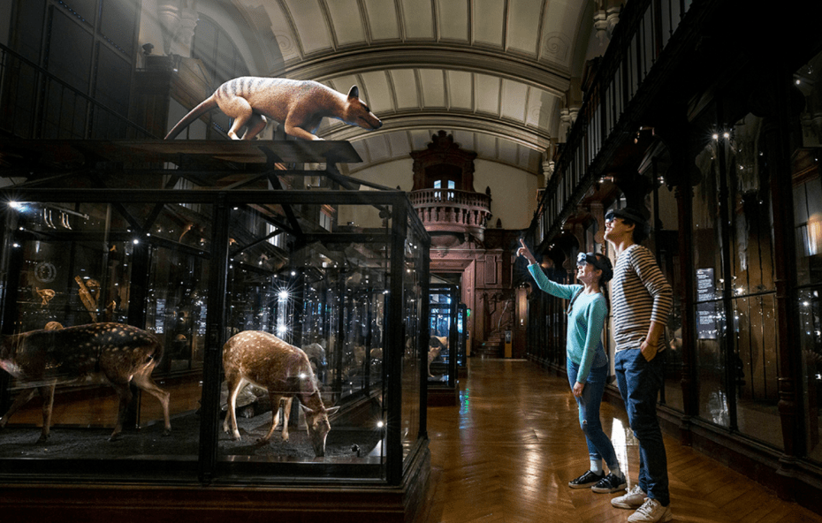
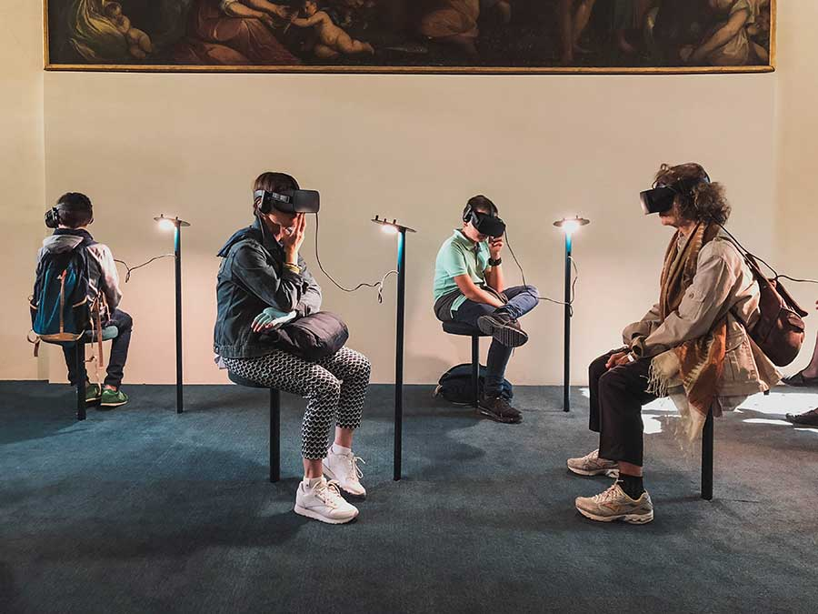
Market Search
National Natural History Museum Paris: "Cabinet of Virtual Reality“
explore various species, observing them up close and to scale, while uncovering the interconnectedness between them.
Notes:
להציג כמה מתחרים- סרטונים ביוטיוב/כתבות

Slide 11
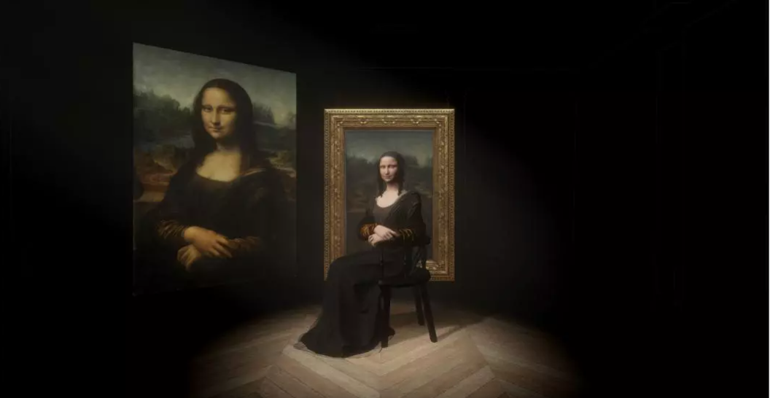
Market Search
The Louvre (France) & HTC Vive : "Mona Lisa: Beyond the Glass."
Notes:
להציג כמה מתחרים- סרטונים ביוטיוב/כתבות

Slide 12
Market Search – Implications for our project
These examples demonstrate how museums around the world are leveraging virtual reality technology to enhance visitor engagement and provide immersive educational experiences.
By embracing VR, museums can reach wider audiences, offer unique perspectives on their collections, and bring history and culture to life in innovative ways.
Notes:
מסקנה

Slide 13
Metrics - User Engagement
3D Environment
Design and reproduce a portion of the museum’s environment in 3d, making it at least 80% reliable to the real museum.
Time Spent in VR Environment:
Average duration users in VR with the headset on, aiming for a 20 – 30 minutes session.

Slide 14
Metrics - User Engagement
User Interaction Rate:
We are aiming to implement 2 main features for the VR Tour which the user will interact with:
VR exhibit – where the user will be exposed to the museum’s 3d simulated environment and interact with its objects.
Animal Vision Simulation – where the user could get an idea of how some animal visualize the environment.

Slide 15
Metrics- Database Performance
Database Response Time:
Time taken for database queries to execute and return results.
Database Throughput:
Number of database transactions processed per unit of time.
Data Integrity:
Metrics related to the accuracy and consistency of data stored in the database.
Notes:
פה בר נכנס

Slide 16
Functional Requirements
VR Environment Interaction
Users should be able to navigate through the virtual museum environment using VR controllers.
Interactive elements such as doors, buttons, and levers should respond to user actions within the VR environment.
Users should be able to interact with exhibits by selecting, examining, and manipulating objects using VR interactions.

Slide 17
Functional Requirements
Exhibit Display and Information
Exhibits should be displayed within the VR environment with accurate representation through 3D models, textures, and animations.
Information panels or overlays should provide users with relevant details, descriptions, and multimedia content about each exhibit.

Slide 18
Functional Requirements
Database Integration
The system should integrate a database to store information about museum exhibits, including metadata such as name, description, artist information, place and time.
The database should support dynamic content management, allowing administrators to easily create, update, and manage a large mass of exhibitions without requiring significant development effort.
Users should have the ability to access additional information about exhibits, such as historical context, audio guides, or related articles.

Slide 19
Non - Functional Requirements-
Performance
The VR museum application should maintain smooth performance, with consistent frame rates (e.g., 60 FPS) , prevent motion sickness and provide a comfortable user experience.
Loading times for exhibits and database queries should be minimized to ensure seamless exploration within the VR environment.

Slide 20
Non - Functional Requirements
Scalability
The application architecture should be scalable to accommodate additional exhibits, features, and user interactions as the museum expands or evolves over time.
Database scalability should be considered to handle increasing data volumes and concurrent user access without performance degradation.

Slide 21
Non - Functional Requirements
Accessibility
The VR museum application should be accessible to users with disabilities, providing alternative navigation options, audio descriptions, and text-to-speech features.
Consideration should be given to users with motion impairments or VR-related discomfort, providing options for seated or stationary VR experiences.

Slide 22
Non - Functional Requirements
Design
The 3D environments within the VR museum should closely resemble the real museum as much as possible, capturing its architectural layout, lighting conditions, and spatial dimensions.
Environmental sounds and ambient noise should be incorporated to simulate the atmosphere of the museum, providing auditory cues that complement the visual experience.

Slide 23
System Architecture :
The system architecture of the VR museum application may include the following components:
Client-side VR application developed using Unity for immersive user experience.
MySQL database for storing and managing exhibit data, metadata, and user interactions.
Communication protocols (e.g., HTTP, WebSockets) for interaction between client and server components.
Notes:
הסברת הרכיבים והתוכנות במערכת ולמה בחרנו דווקא בהם-בר
Programming Languages and tools
• C# (C - Sharp) – for programming in the unity engine and implementing the VR environment along with all of its features.
• XR Plugin – A built in library for unity VR development.
• MySQL - for database querying and data manipulation.
• JavaScript – for creating a UI application to interface the DB.
• HTML - for web page development.
• HTTP/HTTPS for API endpoints for client-server communication.
VR Hardware Platforms
• Oculus Rift, Oculus Quest (compatible with quest 1, quest 2, and quest 3).
• Compatible VR controllers for user interaction.
3D Modeling and Animation Tools:
• Blender, for creating 3D models or using unity asset store / other sources for 3D models and assets.
Development Tools
• Git for version control and collaborative development.
• GitHub for hosting and managing code repositories in unity.
• Unity version 2021.3 LTS – for VR application development.
• Microsoft Visual Studio 2022 – IDE for C# scripts that will run in Unity.
• Postman – for web API.
• Java Spring Boot - for DB server infrastructure.
• JetBrains’s intellij IDEA – for implementing Java Spring Boot.

Slide 24
Use Cases
User navigates through VR museum environment
• User puts on the VR headset and enters the virtual museum environment.
• Within the VR environment, the user can look around and move using VR controllers or keyboard/mouse inputs.
• The user can explore different sections of the museum, such as galleries, hallways, and exhibition rooms, by walking or teleporting within the virtual space.

Slide 25
Use Cases
Admin manages exhibit database
• Admin users have access to backend tools or interfaces for managing the exhibit database.
• Admins can add new exhibits to the database, providing metadata such as exhibit name, description, location, and associated multimedia content.
• They can edit existing exhibit information, update multimedia assets, or remove outdated exhibits from the database as needed.

Slide 26
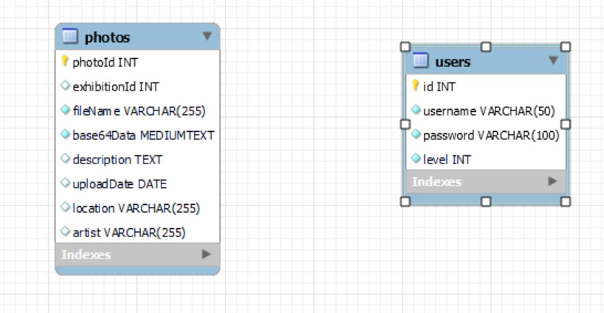
DB Scheme:
*If we manage to meet the deadlines, we will also add a log table for the service activations
Notes:
הסברת הרכיבים והתוכנות במערכת ולמה בחרנו דווקא בהם-בר

Slide 27
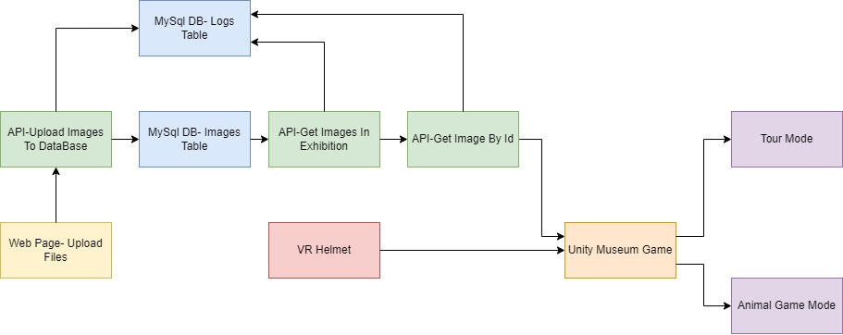
Block Diagram:
Notes:
הסברת הרכיבים והתוכנות במערכת ולמה בחרנו דווקא בהם-בר

Slide 28
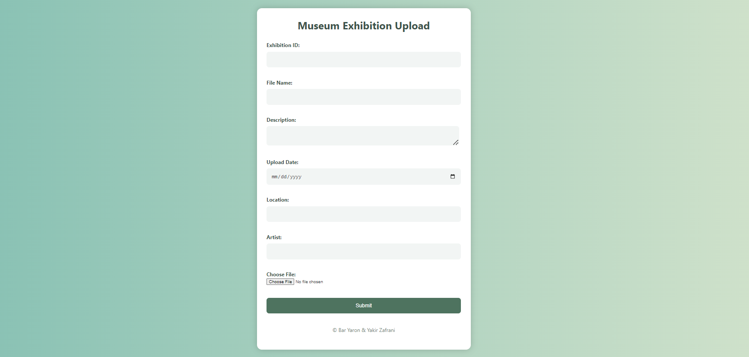
Mockup- Pre Steps
First Stage- The user upload the photos that he would like to present in the exhibiton via web page.
Notes:
להסביר את הפלואו של ההפעלה-בר

Slide 29
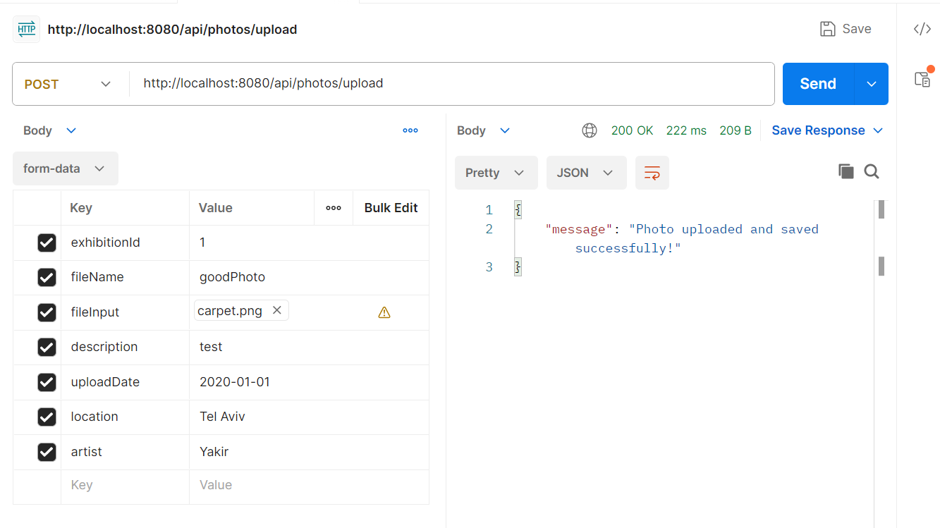
Mockup- Pre Steps
Second Stage- If the user entered the info correctly, we call to an API that write the information in the data base.
Notes:
להסביר את הפלואו של ההפעלה-בר

Slide 30
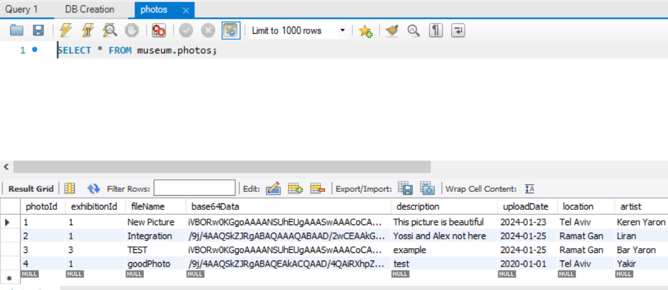
Mockup- Pre Steps
Third Stage- As we can see all the info was written into the data base. The picture itself saved as base64 string because this is the standard of working with files.
Notes:
להסביר את הפלואו של ההפעלה-בר

Slide 31
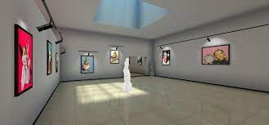
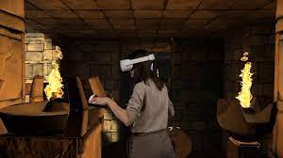
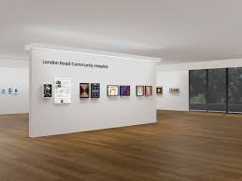
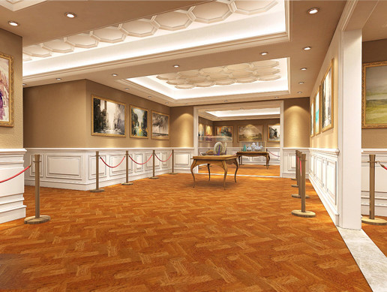
VR museum placeholders
Notes:
להסביר את הפלואו של ההפעלה-בר
In This Part The User Go Into The Unity And Play The Exhibition

Slide 32
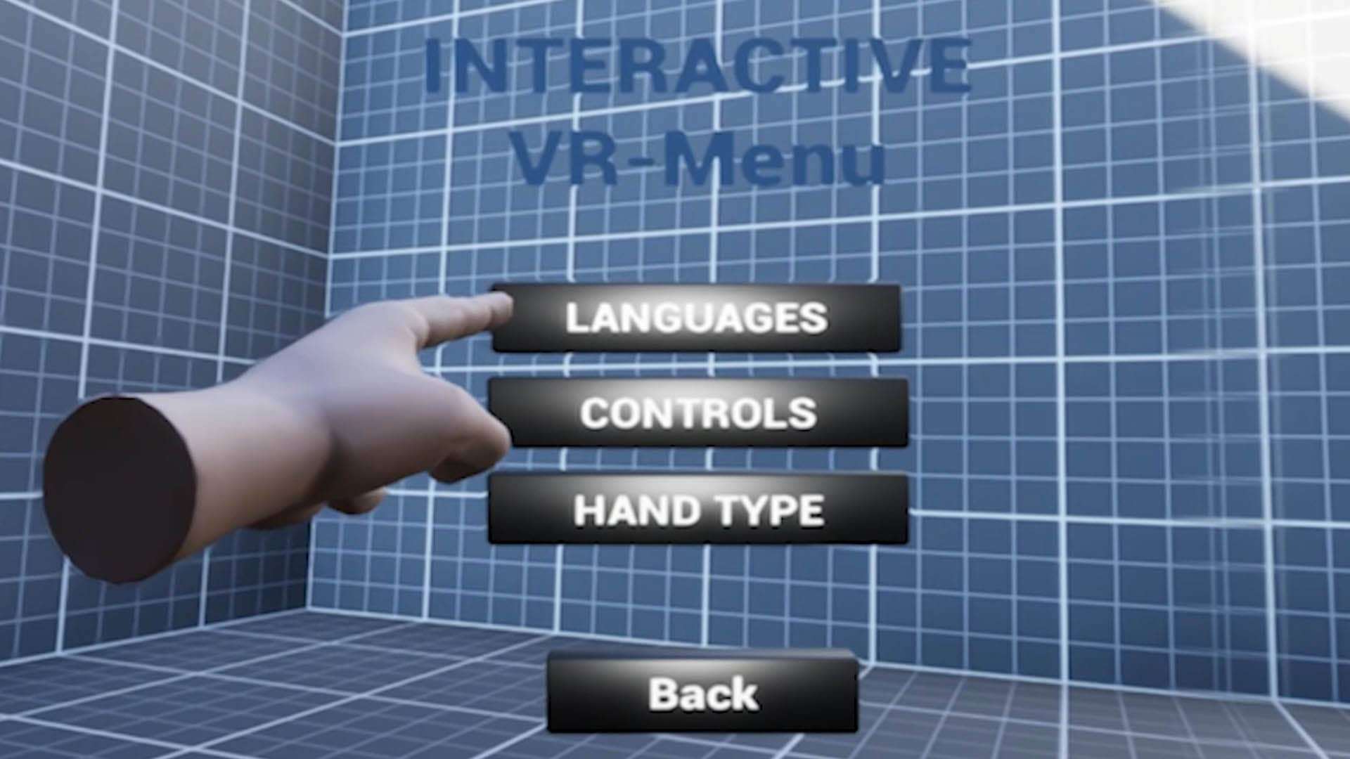
Mockup
First Stage- The operator go into the unity and go into the main menu.
Place Holder For The Photo Of Main Menu In Unity
Notes:
להסביר את הפלואו של ההפעלה-בר

Slide 33
Mockup
Second Stage- We call to an API that get the id’s of all of the photos for the specific exhibition the operator requested.
Place Holder For The API That Gets The Photos ID’s In Specific Exhibition
Notes:
להסביר את הפלואו של ההפעלה-בר

Slide 34
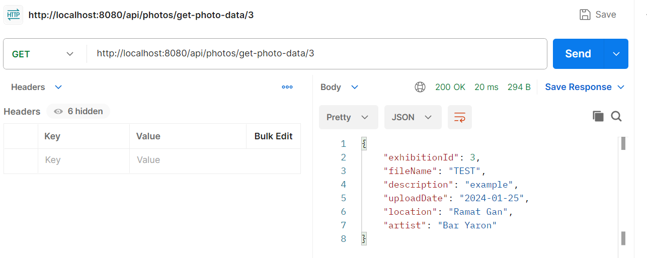
Mockup
Third Stage- We make two API calls for every photo in the array to get the photo itself and to get the photo information.
Notes:
להסביר את הפלואו של ההפעלה-בר

Slide 35
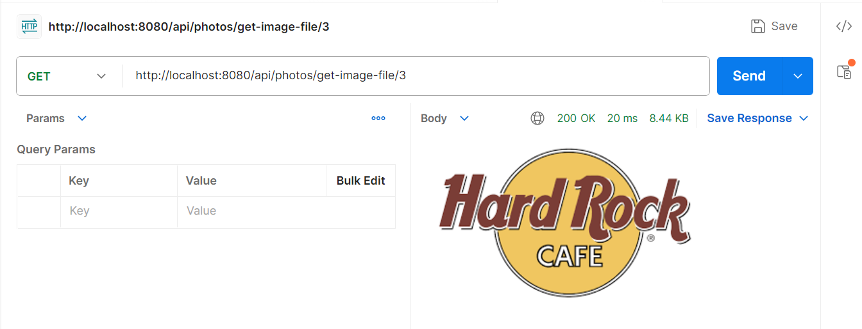
Mockup
Third Stage- We make two API calls for every photo in the array to get the photo itself and to get the photo information.
Notes:
להסביר את הפלואו של ההפעלה-בר

Slide 36
Mockup
Forth Stage- The user starts the tour in the museum via virtual reality .
Place Holder For Running The Game
Notes:
להסביר את הפלואו של ההפעלה-בר

Slide 37
Mockup- Post Steps
For every API call we write the information into the database.
Place Holder For Logs
Notes:
להסביר את הפלואו של ההפעלה-בר

Slide 38
Questions?

Slide 39
Special thanks to the Man and the living world museum for their collaboration.

